Slide 1
A Pattern-Growth Approach for Mining Frequent Itemsets

Slide 2
Introduction to Data Mining
Tan, Steinbach and Vipin Kumar

Slide 3
Drawback of Apriori Algorithm
In many cases the Apriori candidate generate-and-test method significantly reduces the size of candidate sets, leading to good performance gain.
However, it can suffer from two nontrivial costs:
It may still need to generate a huge number of candidate sets.
For example, if there are 10⁴ frequent 1-itemsets, the Apriori algorithm will need to generate more than 10⁷ candidate 2-itemsets.
It may need to repeatedly scan the whole database and check a large set of candidates by pattern matching.
It is costly to go over each transaction in the database to determine the support of the candidate itemsets.

Slide 4
“Can we design a method that mines the complete set of frequent itemsets without such a costly candidate generation process?”

Slide 5
FP-growth
Adopts a divide-and-conquer strategy
First, it encodes the dataset using a compact data structure called an FP-tree and extracts frequent itemsets directly from this structure.
It is constructed by reading the dataset one transaction at a time and mapping each transaction onto a path in the FP-tree.
Different transactions can have several items in common, their paths may overlap.
The more the paths overlaps with one another, the more compression we can achieve using the FP-tree structure.
If the size of the FP-tree is small enough to fit into main memory, this will allow us to extract frequent itemsets directly from the structure in memory instead of making repeated passes over the data store on disk.

Slide 6
The first scan of the database is the same as Apriori, which derives the set of frequent items (1-itemsets) and their support counts (frequencies).
The set of frequent items is sorted in the order of descending support count.
For the example we will use, the order of items is: a, b, c, d, e
a is the most frequent item followed by b, c, d, e
Infrequent items are discarded
Items in transactions will be ordered in descending support count.
The algorithm makes a second pass over the data to construct the FP-tree

Slide 7
FP-Tree structure
Initially the FP-tree contains only the root node represented by the Null
Each node contains the label of an item along with a counter
Counter
Shows the number of transactions mapped onto the given path.

Slide 8
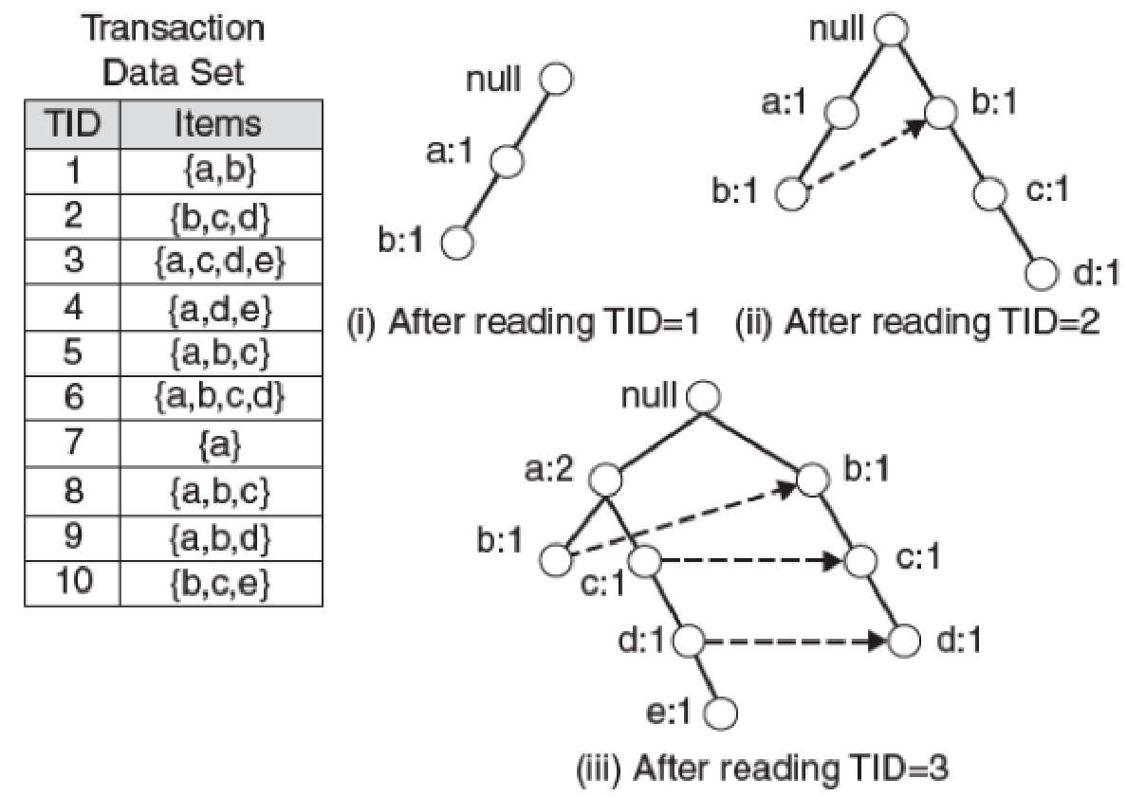
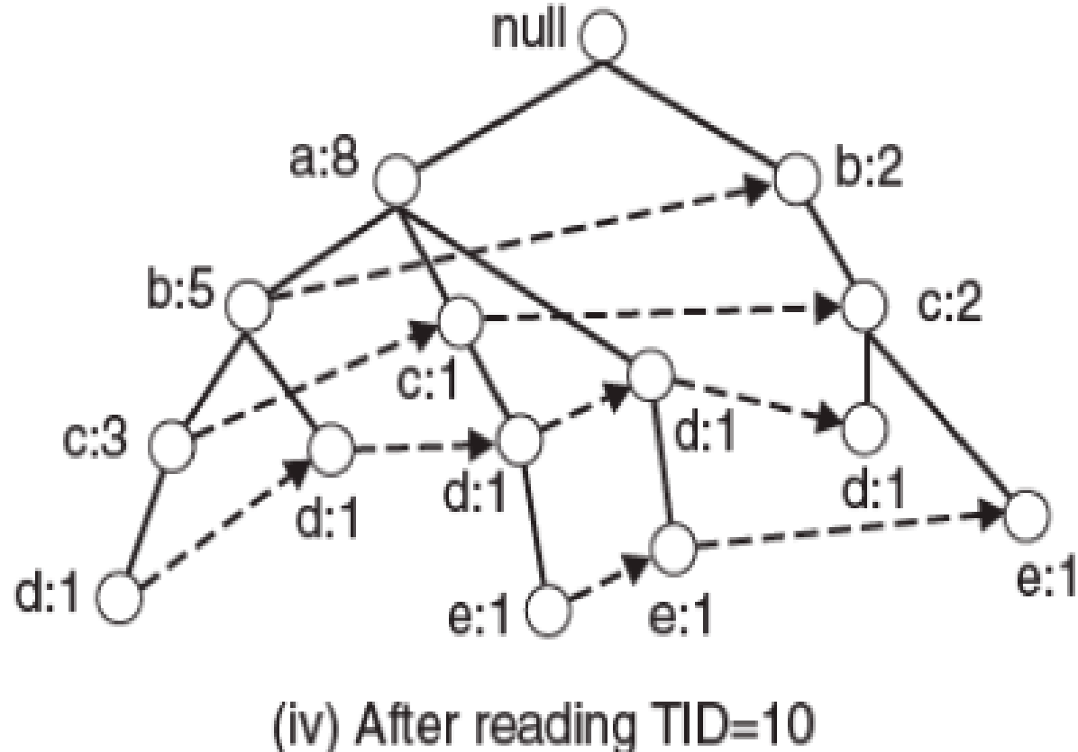
Construction of an FP-tree

Slide 9
Construction of FP-Tree
After reading the first transaction {a,b}, the nodes labeled as a and b are created
A path is then formed from null🡪a🡪b to encode the transaction.
Every node along the path has a frequency count of 1.
Similarly other paths are created corresponding to other transactions.
An FP-tree also contains a list of pointers connecting between nodes that have the same items.
These pointers are represented as a dashed lines
these pointers are used to generate the frequent itemsets

Slide 10
Size of the FP-tree
The size of an FP-tree is typically smaller than the size of the uncompressed data because
Many transactions often share a few items in common.
The best case scenario
All the transactions have the same set of items
So FP-tree contains only a single branch of nodes.
The worst case scenario
Every transaction has a unique set of items
So size of the FP-tree is effectively same as the size of the original data
But physical storage requirement for the FP-tree is higher
As it requires additional space to store pointers between nodes and counters of each item.

Slide 11
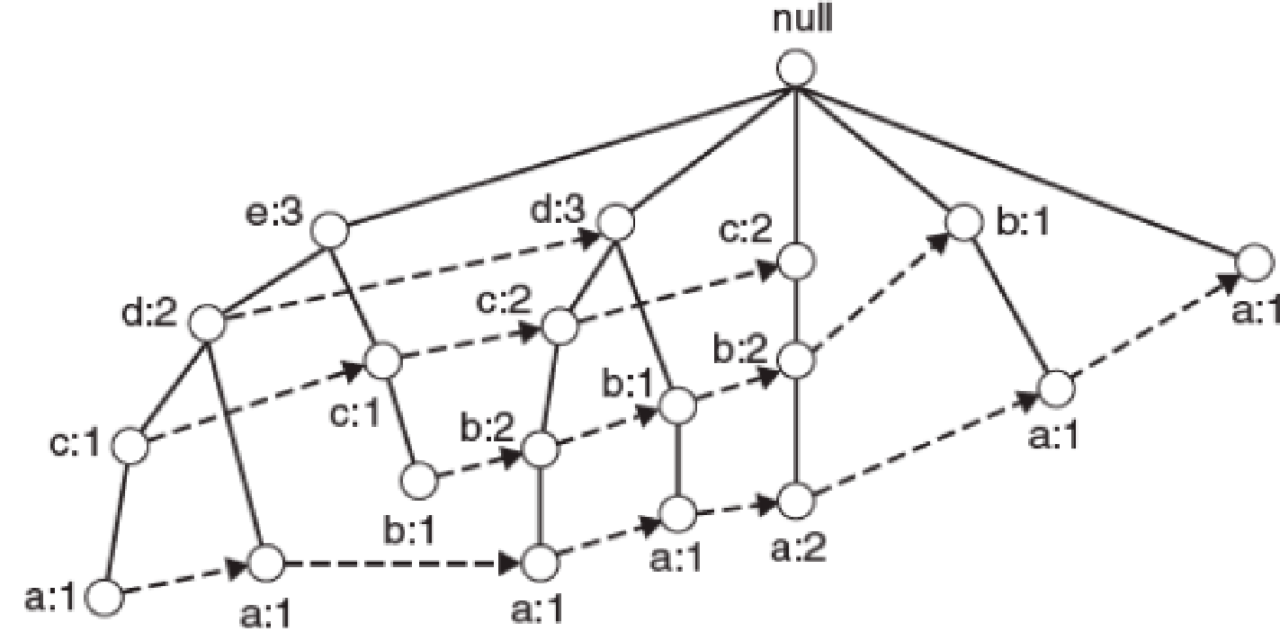
Size of the FP-tree
It also depends on how the items are ordered.
If the ordering scheme is reversed 🡪 from lowest to highest support count, the resulting FP-tree
Items in transactions will be ordered in ascending support count.

Slide 12
Frequent itemset generation in FP-growth Algorithm
Frequent itemsets are generated by exploring the FP-tree in a bottom up fashion.
In the example taken, the algorithm looks for frequent itemsets ending in e first, followed by d, c, b, a
Since every transaction is mapped onto a path in the FP-tree, we can derive the frequent itemsets ending with a particular item, say e, by examining only the paths containing that item (node e).
These paths can be accessed rapidly using the pointers associated with node e.
The extracted paths are shown in next slide.
These paths will be used to obtain frequent itemsets.

Slide 13
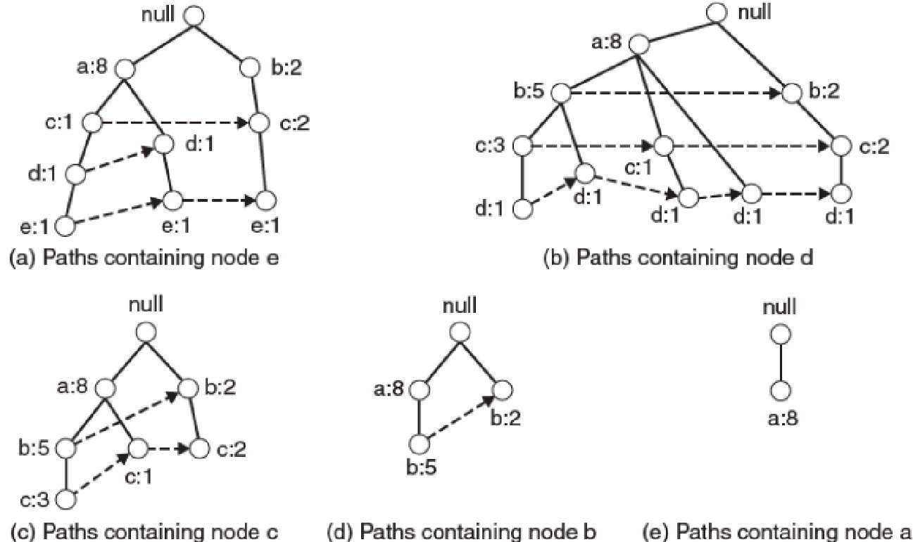
Decomposing the frequent itemset generation problem into multiple subproblems, where each subproblem involves frequent itemsets ending in e, d, c, b, a

Slide 14
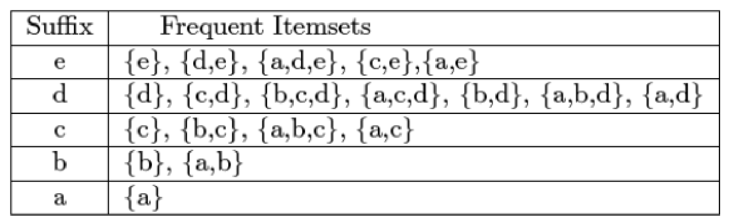
These above paths are used to obtain the corresponding itemsets

Slide 15
FP-growth finds all the frequent itemsets ending with a particular with a particular suffix by employing a divide and conquer strategy
To find all frequent itemsets ending with e
First we check if e is itself frequent item
If it is frequent, we consider the subproblem of finding frequent itemsets ending in de, followed by ce, be, ae.
In turn each of these subproblems are further decomposed into smaller subproblems.
Then we merge the solutions obtained from the subproblems to find all the frequent itemsets ending in e can be found.

Slide 16
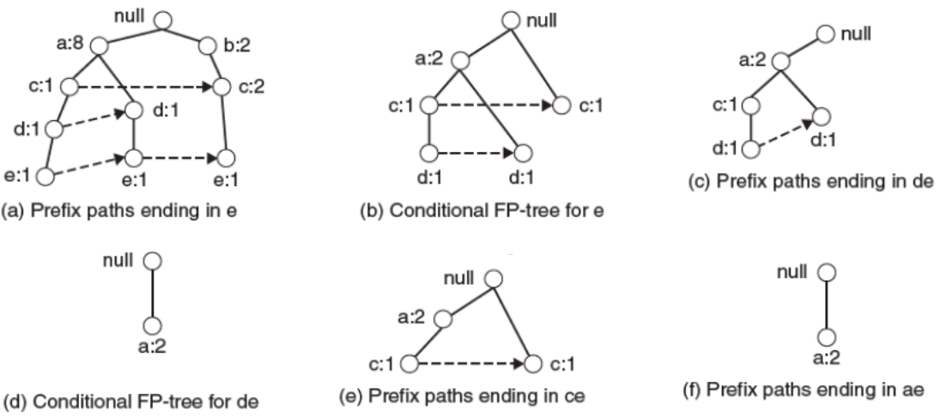
Example of applying the FP-growth algorithm to find frequent itemsets ending in e

Slide 17
Example: Finding frequent itemsets ending with e
Gather all the paths containing node e: called as prefix paths
From this prefix paths, the support count for e is obtained by adding the support counts associated with node e.
Assuming the minimum support count is 2, e is frequent item as its support count is 3
So the next task is to solve subproblems of finding frequent itemsets ending in de, ce, be, ae.
Before this, the prefix paths is converted into a conditional FP-tree.
It is structurally similar to FP-tree and it is used to find frequent itemsets ending with a particular suffix.

Slide 18
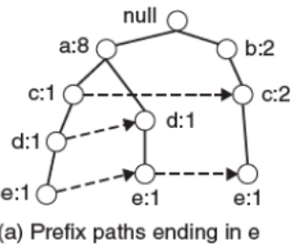

Slide 19
Example: Finding frequent itemsets ending with e
Obtaining conditional FP-tree
First the support counts along the prefix paths must be updated because some of the counts include transactions that do not contain item (e in this case)
The prefix paths are truncated by removing the nodes for e. (As the support counts along the prefix paths have been updated to reflect only transactions that contain e thus the subproblems of finding frequent itemsets ending in de, ce, be, and ae no longer need information about node e.
After updating the support counts along the prefix paths, some of the items may no longer be frequent.

Slide 20
Example: Finding frequent itemsets ending with e
Obtaining conditional FP-tree for e
the support counts along the prefix paths must be updated
The rightmost path null->b:2->c:2->e:1, includes a transaction {b, c} that does not contain item e. The count along the prefix path must therefore be adjusted to 1 to reflect the actual number of transactions containing {b,c,e}
The prefix paths are truncated by removing the nodes for e.
After updating the support counts along the prefix paths, some of the items may no longer be frequent
The node b appears only once and has a support count equal to 1, which means there is only one transaction that contains both b and e. Item b can be safely ignored from subsequent analysis because all itemsets ending in be must be infrequent.

Slide 21
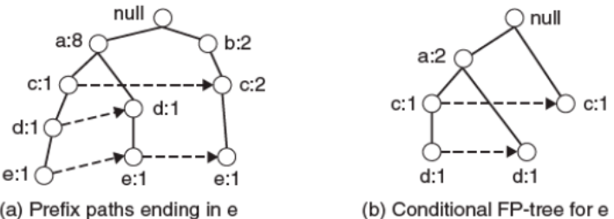

Slide 22
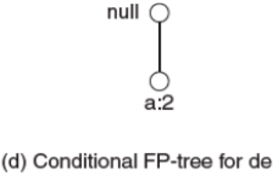
Solving subproblems of finding frequent itemsets ending in de, ce, ae using conditional FP-tree for e
Finding frequent itemsets ending in de
The prefix path for d are gathered
Adding the frequency counts associated with node d, we obtain the support count for {d, e}
Since the support count is equal 2, {d, e} is frequent itemset.
Next, the algorithm constructs the conditional FP-tree for de
updating the support counts and remove the infrequent item c
It contains only one item- a, and its support is equal to minsup, the algorithm extract the frequent itemset {a,d,e}

Slide 23
Solving subproblems of finding frequent itemsets ending in de, ce, ae using conditional FP-tree for e
Generate frequent itemsets ending in ce
After processing the prefix paths for c, only {c, e} is found to be frequent.
Generate frequent itemsets ending in ae
Founds {a,e} to be only frequent itemset.

Slide 24
General Remarks
Since the subproblems are disjoints, FP-growth will not generate any duplicate itemsets.
Counts associated with the nodes allow the algorithm to perform support counting while generating the common suffix itemsets.
For certain transactional datasets, FP-growth outperforms the standard Apriori algorithm by several orders of magnitude.
The run-time performance of FP-growth depends on the compaction factor of the data set.
If the resulting conditional FP-trees are very bushy (in the worst case, a full prefix tree), then the performance of the algorithm degrades significantly because it has to generate a large number of subproblems and merge the results returned by each subproblem.

Slide 25
Data Mining concepts and Techniques
Han, Kamber & Pei

Slide 26
FP-Tree
It then divides the compressed database into a set of conditional databases (a special kind of projected database), each associated with one frequent item or “pattern fragment,” and mines each database separately.
For each “pattern fragment,” only its associated data sets need to be examined.
Therefore, this approach may substantially reduce the size of the data sets to be searched, along with the “growth” of patterns being examined.

Slide 27
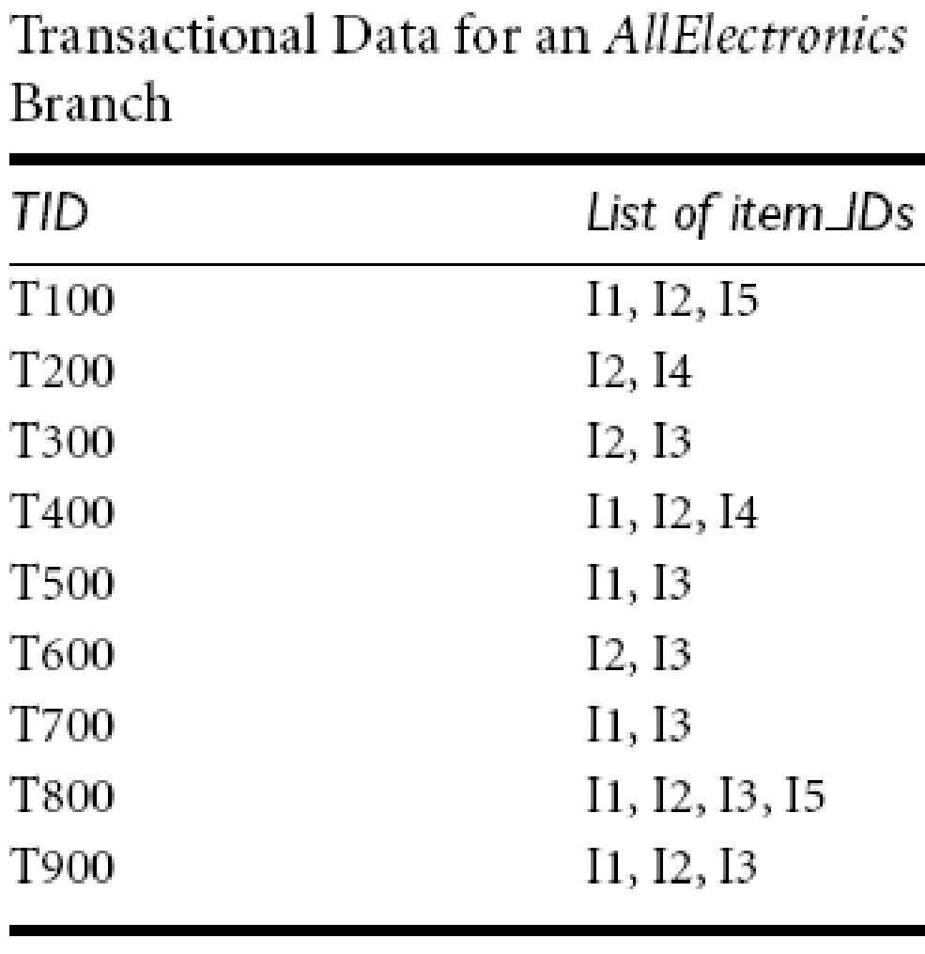

Slide 28
FP-growth
The first scan of the database is the same as Apriori, which derives the set of frequent items (1-itemsets) and their support counts (frequencies).
The set of frequent items is sorted in the order of descending support count.
This resulting set or list is denoted by L.
Thus, we have L = {{I2: 7}, {I1: 6}, {I3: 6}, {I4: 2}, {I5: 2}} (Since the minimum support=2)

Slide 29
FP-growth
Then an FP-tree is constructed:
First, create the root of the tree, labeled with “null.”
Scan database D a second time.
The items in each transaction are processed in L order (i.e., sorted according to descending support count), and a branch is created for each transaction.
For example, the scan of the first transaction, “T100: I1, I2, I5,” which contains three items (I2, I1, I5 in L order), leads to the construction of the first branch of the tree with three nodes, <I2: 1>, <I1: 1>, and <I5: 1>, where I2 is linked as a child to the root, I1 is linked to I2, and I5 is linked to I1. The second transaction, T200, contains the items I2 and I4 in L order, which would result in a branch where I2 is linked to the root and I4 is linked to I2. However, this branch would share a common prefix, I2, with the existing path for T100. Therefore, we instead increment the count of the I2 node by 1, and create a new node, <I4: 1?, which is linked as a child to <I2: 2>.
In general when considering the branch to be added for a transaction, the count of each node along a common prefix is incremented by 1, and nodes for the items following the prefix are created and linked accordingly

Slide 30
To facilitate tree traversal, an item header table is built so that each item points to its occurrences in the tree via a chain of node-links.
The tree obtained after scanning all the transactions is shown in the Figure with the associated node-links.
In this way, the problem of mining frequent patterns in databases is transformed into that of mining the FP-tree.

Slide 31
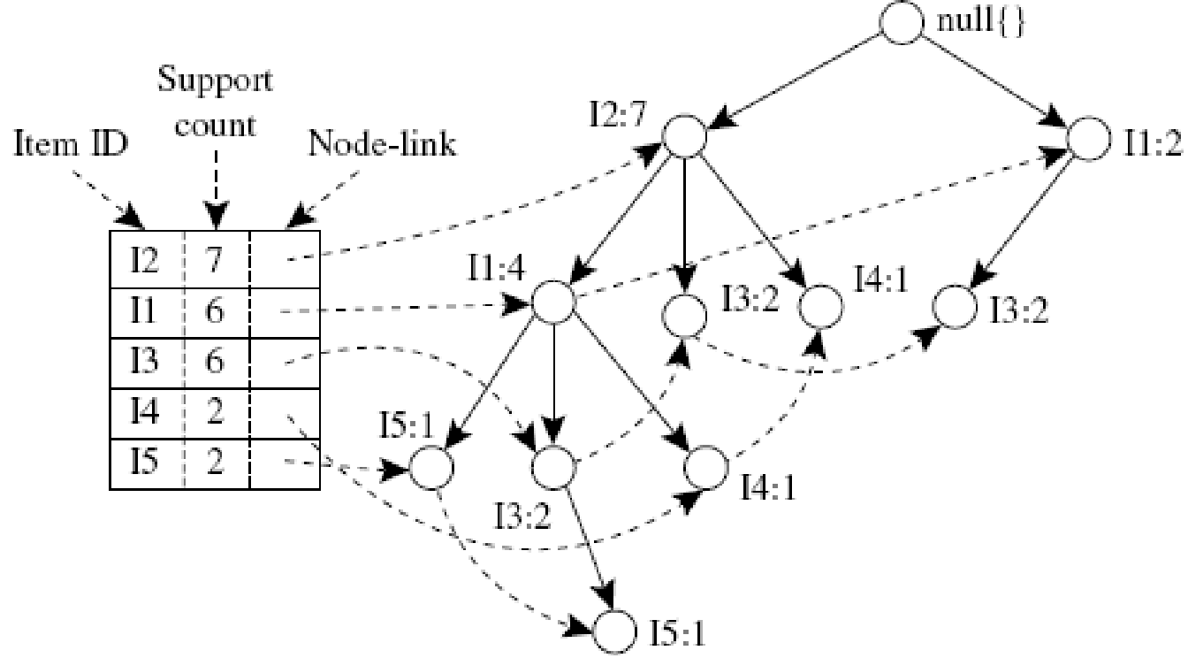
An FP-tree registers compressed, frequent pattern information

Slide 32
Mining the FP-tree
Start from each frequent length-1 pattern (as an initial suffix pattern), construct its conditional pattern base (a “sub-database,” which consists of the set of prefix paths in the FP-tree co-occurring with the suffix pattern), then construct its (conditional) FP-tree, and performing recursively on the tree.
The pattern growth is achieved by the concatenation of the suffix pattern with the frequent patterns generated from a conditional FP-tree.

Slide 33
Mining FP tree: Example
first consider I5, which is the last item in L, rather than the first.
I5 occurs in two FP-tree branches of previous Figure. (The occurrences of I5 can easily be found by following its chain of node-links.)
The paths formed by these branches are <I2, I1,I5: 1> and <I2, I1, I3, I5: 1>.
Therefore, considering I5 as a suffix, its corresponding two prefix paths are <I2, I1: 1> and <I2, I1, I3: 1>, which form its conditional pattern base.
Using this conditional pattern base as a transaction database, we build an I5-conditional FP-tree, which contains only a single path, <I2: 2, I1: 2>;
I3 is not included because its support count of 1 is less than the minimum support count.
The single path generates all the combinations of frequent patterns: {I2, I5: 2}, {I1, I5: 2}, {I2, I1, I5: 2}.

Slide 34
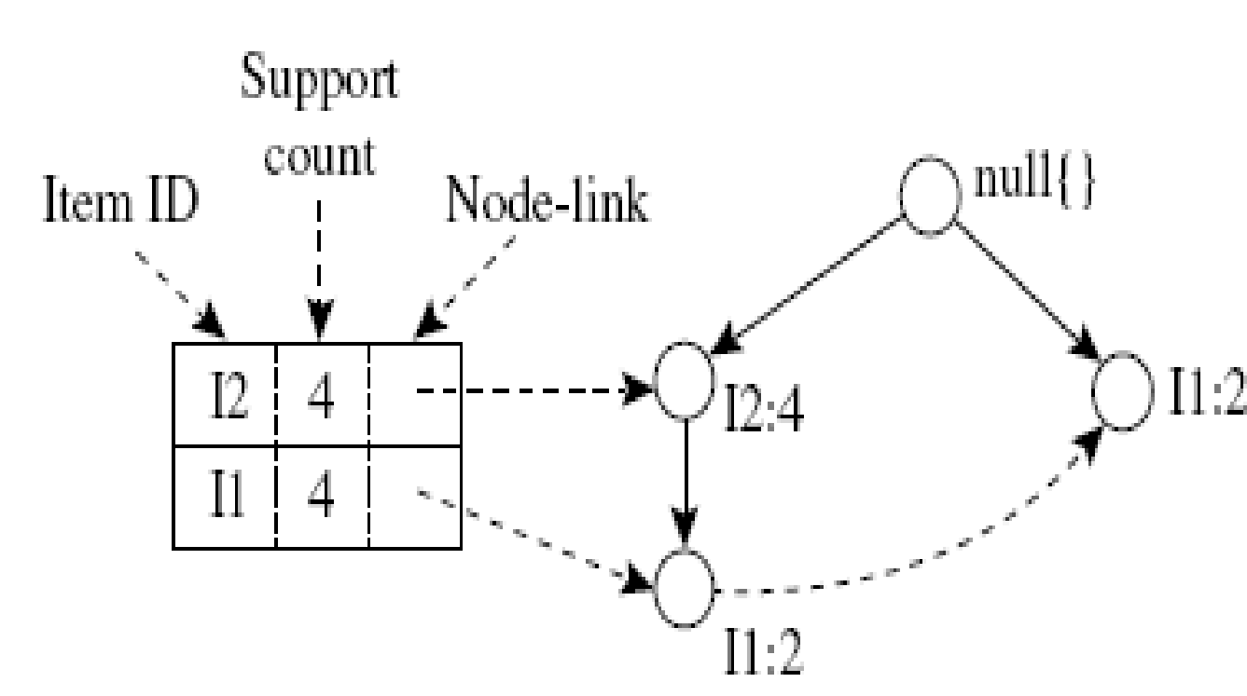
For I4, its two prefix paths form the conditional pattern base, {{I2 I1: 1}, {I2: 1}}, which generates a single-node conditional FP-tree, <I2: 2>, and derives one frequent pattern, {I2, I4: 2}.
Similar to the preceding analysis, I3’s conditional pattern base is {{I2, I1: 2}, {I2: 2}, {I1: 2}}.
Its conditional FP-tree has two branches, <I2: 4, I1: 2> and <I1: 2>, as shown in this Figure, which generates the set of patterns {{I2, I3: 4}, {I1, I3: 4}, {I2, I1, I3: 2}}.
Finally, I1’s conditional pattern base is {{I2: 4}}, with an FP-tree that contains only one node, <I2: 4>, which generates one frequent pattern, {I2, I1: 4}.
This mining process is summarized in the next Figure.

Slide 35
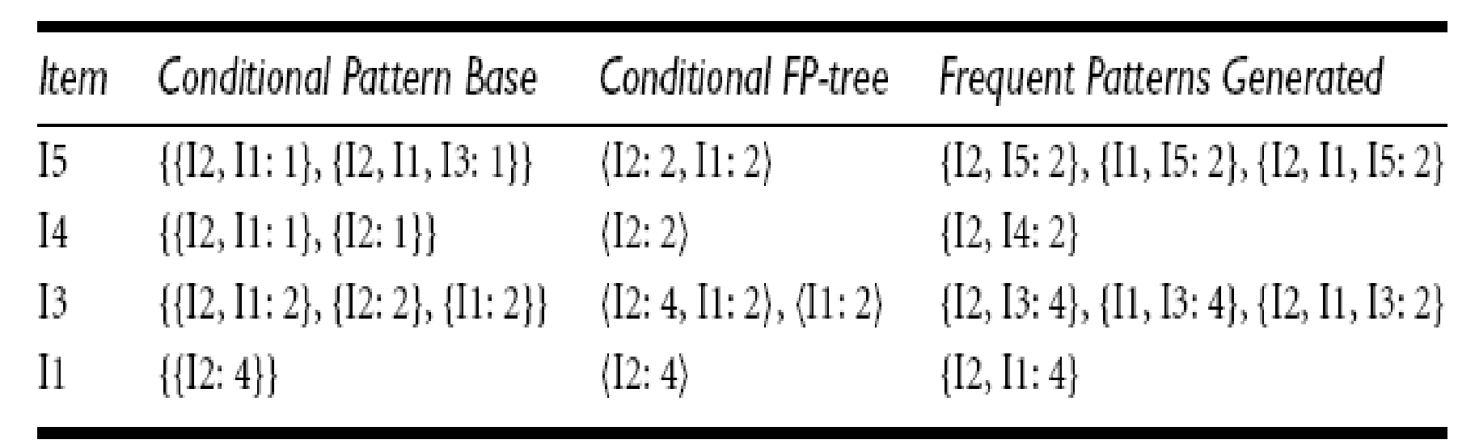
Mining the FP-Tree by Creating Conditional (Sub-)Pattern Bases

Slide 36
The FP-growth method transforms the problem of finding long frequent patterns into searching for shorter ones in much smaller conditional databases recursively and then concatenating the suffix.
It uses the least frequent items as a suffix, offering good selectivity.
The method substantially reduces the search costs.
When the database is large, it is sometimes unrealistic to construct a main memory based FP-tree.
An interesting alternative is to first partition the database into a set of projected databases, and then construct an FP-tree and mine it in each projected database.
This process can be recursively applied to any projected database if its FP-tree still cannot fit in main memory.
A study of the FP-growth method performance shows that it is efficient and scalable for mining both long and short frequent patterns, and is about an order of magnitude faster than the Apriori algorithm.

